Slide 1
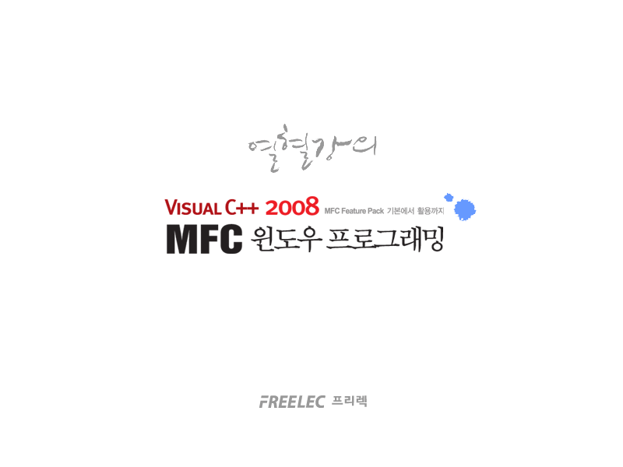

Slide 2
Part 5
  Miscellaneous topic

Slide 3
Chapter 33
  Registry

Slide 4
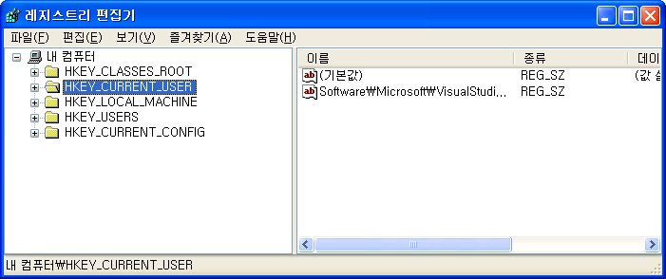
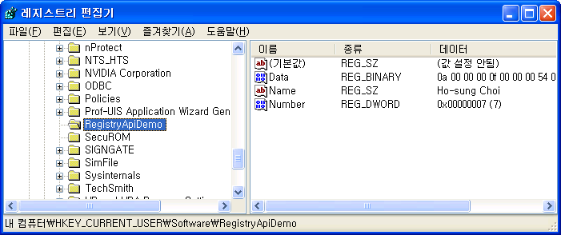
Registry

Slide 5
RegistryApiDemo
163
164 void CRegistryApiDemoDlg::OnBnClickedButtonCreatekey( )
165 {
166 DWORD dwReturn = 0;
167 HKEY hKey = NULL;
168
169 dwReturn = ::RegCreateKeyEx(HKEY_CURRENT_USER,
170 _T("Software\\RegistryApiDemo"),
171 0,
172 NULL,
173 REG_OPTION_NON_VOLATILE,
174 KEY_ALL_ACCESS,
175 NULL,
176 &hKey,
177 NULL);
178 if(dwReturn != ERROR_SUCCESS)
179 {
180 AfxMessageBox(_T("ERROR: Failed to create new registry key!"));
181 return;
182 }
183
184 ::RegCloseKey(hKey);
185 }
186

Slide 6
RegistryApiDemo
LONG RegCreateKeyEx(
HKEY hKey,
LPCTSTR lpSubKey,
DWORD Reserved,
LPTSTR lpClass,
DWORD dwOptions,
REGSAM samDesired,
LPSECURITY_ATTRIBUTES lpSecurityAttributes,
PHKEY phkResult,
LPDWORD lpdwDisposition
);
LONG RegOpenKeyEx(
HKEY hKey,
LPCTSTR lpSubKey,
DWORD ulOptions,
REGSAM samDesired,
PHKEY phkResult
);

Slide 7
RegistryApiDemo
LONG RegSetValueEx(
HKEY hKey,
LPCTSTR lpValueName,
DWORD Reserved,
DWORD dwType,
const BYTE* lpData,
DWORD cbData
);
LONG RegQueryValueEx(
HKEY hKey,
LPCTSTR lpValueName,
LPDWORD lpReserved,
LPDWORD lpType,
LPBYTE lpData,
LPDWORD lpcbData
);

Slide 8
RegistryApiDemo
값 | 의미
REG_BINARY | 바이너리 형식입니다. 모든 형식의 데이터가 다 해당합니다. 확장성이 가장 좋습니다.
REG_DWORD | 32비트 정수 형식입니다.
REG_DWORD_LITTLE_ENDIAN | 32비트 정수를 리틀 인디안 형식으로 처리합니다.
REG_DWORD_BIG_ENDIAN | 32비트 정수를 빅 인디안 형식으로 처리합니다.
REG_EXPAND_SZ | 환경 변수와 같은 문자를 포함하는 문자열 형식입니다. (예, %PATH%, 유니코드)
REG_LINK | 유니코드 심볼릭 링크 형식입니다.
REG_MULTI_SZ | NULL로 끝나는 문자열 형식입니다. 맨 마지막에는 NULL이 두 번 들어가야 합니다.
REG_NONE | 정의되지 않은 형식입니다.
REG_QWORD | 64비트 정수 형식입니다.
REG_QWORD_LITTLE_ENDIAN | 64비트 정수를 리틀 인디안 형식으로 처리합니다.
REG_RESOURCE_LIST | 장치 드라이버 리소스 목록 형식입니다.
REG_SZ | 문자열 형식입니다.

Slide 9
RegistryApiDemo
235 void CRegistryApiDemoDlg::OnBnClickedButtonSetdata( )
236 {
237 TEST_DATA TestData;
238 ::ZeroMemory(&TestData, sizeof(TestData));
239 TestData.nType = 10;
240 TestData.dwData = 15;
241 wsprintf(TestData.szData, _T("%s"), _T("TEST DATA STRING"));
242
243 DWORD dwReturn = 0;
244 HKEY hKey = NULL;
245 dwReturn = ::RegOpenKeyEx(HKEY_CURRENT_USER,
246 _T("Software\\RegistryApiDemo"),
247 0,
248 KEY_WRITE,
249 &hKey);
250 if(dwReturn == ERROR_SUCCESS)
251 {
252 ::RegSetValueEx(hKey,
253 _T("Data"),
254 NULL,
255 REG_BINARY,
256 (BYTE*)&TestData,
257 sizeof(TestData));
258
259 ::RegCloseKey(hKey);

Slide 10
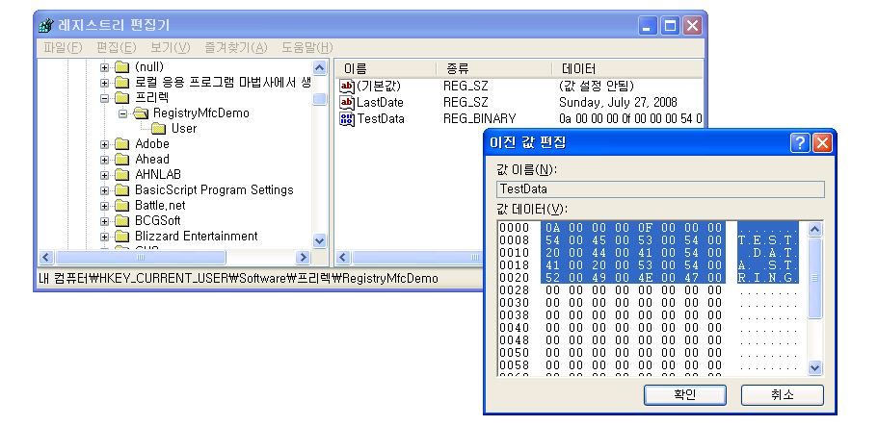
RegistryApiDemo

Slide 11
RegistryApiDemo
272
273 dwReturn = ::RegOpenKeyEx(HKEY_CURRENT_USER,
274 _T("Software\\RegistryApiDemo"),
275 0,
276 KEY_READ,
277 &hKey);
278 if(dwReturn == ERROR_SUCCESS)
279 {
280 dwBufferSize = sizeof(szName);
281 dwReturn = ::RegQueryValueEx(hKey, TEXT("Name"), NULL, NULL,
282 (BYTE*)szName, &dwBufferSize);
283
284 dwBufferSize = sizeof(dwNumber);
285 dwReturn = ::RegQueryValueEx(hKey, TEXT("Number"), NULL, NULL,
286 (BYTE*)&dwNumber, &dwBufferSize);
287
288 dwBufferSize = sizeof(TestData);
289 dwReturn = ::RegQueryValueEx(hKey, TEXT("Data"), NULL, NULL,
290 (BYTE*)&TestData, &dwBufferSize);

Slide 12
EnumSoftware
155
156 void CEnumSoftwareDlg::OnBnClickedButtonInstalledsoftware( )
157 {
158 if(m_List.GetCount( ) > 0) m_List.ResetContent( );
159
160 CString csSWKey =
161 _T("Software\\Microsoft\\Windows\\CurrentVersion\\Uninstall");
162 CString csSubKey = _T("");
163
164 DWORD dwIndex = 0;
165 DWORD dwType = 0;
166 TCHAR szKeyName[MAX_PATH] = {0};
167 TCHAR szValue[MAX_PATH] = {0};
168 DWORD dwBufferSize = 0;
169 HKEY hKey = NULL, hKeySub = NULL;
170
171 DWORD dwResult = ::RegOpenKeyEx(HKEY_LOCAL_MACHINE,
172 (LPCTSTR)csSWKey, 0, KEY_READ, &hKey);
173 if(dwResult != ERROR_SUCCESS)
174 {
175 AfxMessageBox(_T("ERROR: Failed to open registry key!"));
176 return;
177 }
178

Slide 13
EnumSoftware
178
179 dwBufferSize = MAX_PATH;
180 while(::RegEnumKey(hKey,
181 dwIndex,
182 szKeyName,
183 dwBufferSize) != ERROR_NO_MORE_ITEMS)
184 {
185 csSubKey = csSWKey + TEXT("\\") + szKeyName;
186 dwResult = ::RegOpenKeyEx(HKEY_LOCAL_MACHINE,
187 (LPCTSTR)csSubKey, 0, KEY_READ, &hKeySub);
188 if(dwResult != ERROR_SUCCESS)
189 {
190 dwIndex++;
191 ::ZeroMemory(szKeyName, MAX_PATH);
192 dwBufferSize = MAX_PATH;
193 continue;
194 }
195

Slide 14
EnumSoftware
195
196 dwType = 0;
197 ::ZeroMemory(szValue, MAX_PATH);
198 dwBufferSize = MAX_PATH;
199 if(::RegQueryValueEx(hKeySub, _T("DisplayName"), NULL, &dwType,
200 (BYTE*)szValue, &dwBufferSize) == ERROR_SUCCESS)
201 {
202 m_List.AddString(szValue);
203 }
204
205 ::RegCloseKey(hKeySub);
206 dwIndex++;
207 ::ZeroMemory(szKeyName, MAX_PATH);
208 dwBufferSize = MAX_PATH;
209 }
210
211 ::RegCloseKey(hKey);

Slide 15
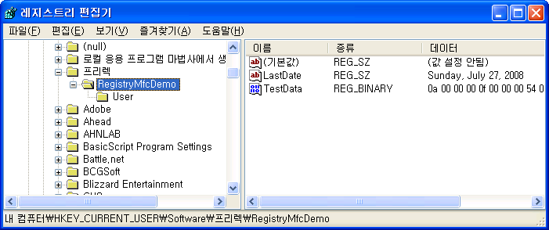
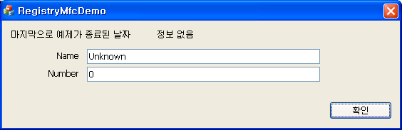
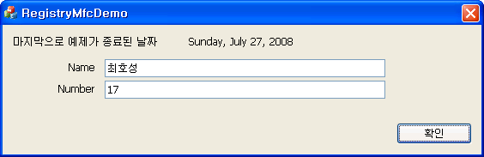
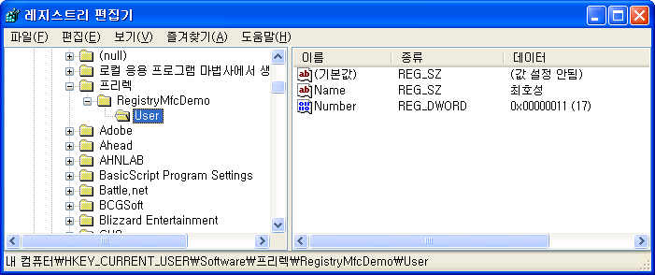
RegistryMfcDemo

Slide 16
RegistryMfcDemo
48
49 CWinAppEx::InitInstance( );
50 AfxEnableControlContainer( );
51
52 SetRegistryKey(_T("프리렉"));
53
54 CRegistryMfcDemoDlg dlg;
55 m_pMainWnd = &dlg;
56
57 UINT uRead = 0;
58 BYTE* pData = NULL;
59 dlg.m_strLastDate = GetProfileString(_T(""), _T("LastDate"), _T("정보없음"));
60 dlg.m_strName = GetProfileString(_T("User"), _T("Name"), _T("Unknown"));
61 dlg.m_dwNumber = GetProfileInt(_T("User"), _T("Number"), 0);
62
63 if(GetProfileBinary(_T(""), _T("TestData"), &pData, &uRead))
64 {
65 TEST_DATA* pTestData = (TEST_DATA*)pData;
66 delete[] pData;
67 }
68
69 INT_PTR nResponse = dlg.DoModal( );
70 if (nResponse == IDOK)

Slide 17
RegistryMfcDemo
- CString GetProfileString(
LPCTSTR lpszSection,
LPCTSTR lpszEntry,
LPCTSTR lpszDefault = NULL
);
- UINT GetProfileInt(
LPCTSTR lpszSection,
LPCTSTR lpszEntry,
int nDefault
);
- BOOL GetProfileBinary(
LPCTSTR lpszSection,
LPCTSTR lpszEntry,
LPBYTE* ppData,
UINT* pBytes
);

Slide 18
Chapter 33
  Shell interface

Slide 19
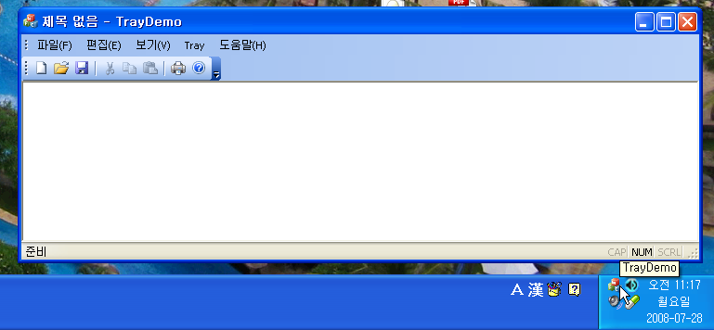
TrayDemo

Slide 20
TrayDemo
287
288 void CMainFrame::GotoTray(void)
289 {
290 NOTIFYICONDATA nid;
291 ::ZeroMemory(&nid, sizeof(nid));
292 nid.cbSize = sizeof(nid);
293 nid.hWnd = m_hWnd;
294 nid.uID = IDR_MAINFRAME;
295 nid.uFlags = NIF_MESSAGE | NIF_ICON | NIF_TIP;
296 nid.uCallbackMessage = UM_TRAY;
297 nid.hIcon = AfxGetApp( )->LoadIcon(IDR_MAINFRAME);
298 wsprintf(nid.szTip, _T("%s"), _T("TrayDemo"));
299
300 ::Shell_NotifyIcon(NIM_ADD, &nid);
301 }
302

Slide 21
TrayDemo
BOOL Shell_NotifyIcon(
DWORD dwMessage,
PNOTIFYICONDATA lpdata
);
값 | 의미
NIM_ADD | 트레이에 아이콘을 등록합니다.
NIM_DELETE | 트레이에 등록된 아이콘을 해제합니다.
NIM_MODIFY | 트레이에 등록된 아이콘을 변경합니다.
NIM_SETFOCUS | 트레이에 등록된 아이콘이 선택되도록 포커스를 줍니다.
NIM_SETVERSION | 두 번째 인자에서의 쉘 버전에 맞추어 동작하도록 합니다.

Slide 22
TrayDemo
302
303 void CMainFrame::OnDestroy( )
304 {
305 NOTIFYICONDATA nid;
306 nid.cbSize = sizeof(nid);
307 nid.hWnd = m_hWnd;
308 nid.uID = IDR_MAINFRAME;
309 ::Shell_NotifyIcon(NIM_DELETE, &nid);
310
311 CFrameWndEx::OnDestroy( );
312 }
313
343
344 void CMainFrame::OnClose( )
345 {
346 ShowWindow(SW_HIDE);
347 // CFrameWndEx::OnClose( );
348 }
349

Slide 23
TrayDemo
313
314 LRESULT CMainFrame::OnTray(WPARAM wParam, LPARAM lParam)
315 {
316 if(lParam == WM_RBUTTONDOWN)
317 {
318 SetCapture( );
319 }
320 else if(lParam == WM_RBUTTONUP)
321 {
322 CMenu menu, *pMenu = NULL;
323 CPoint pt;
324
325 menu.LoadMenu(IDR_Tray);
326 pMenu = menu.GetSubMenu(0);
327
328 GetCursorPos(&pt);
329 SetForegroundWindow( );
330 pMenu->TrackPopupMenu(TPM_LEFTALIGN | TPM_LEFTBUTTON,
331 pt.x, pt.y, this);
332 ::PostMessage(m_hWnd, WM_NULL, 0, 0);
333
334 ReleaseCapture( );
335 }

Slide 24
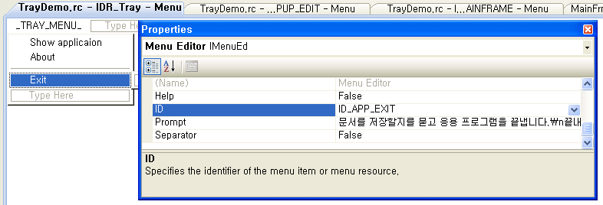
TrayDemo
332 ::PostMessage(m_hWnd, WM_NULL, 0, 0);
333
334 ReleaseCapture( );
335 }
336 else if(lParam == WM_LBUTTONDBLCLK)
337 {
338 ShowWindow(SW_SHOW);
339 SetForegroundWindow( );
340 }
341 return 0;
342 }
343

Slide 25
TrayDemo
359
360 void CMainFrame::OnMenuToggleicon( )
361 {
362 NOTIFYICONDATA nid;
363 ::ZeroMemory(&nid, sizeof(nid));
364 nid.cbSize = sizeof(nid);
365 nid.hWnd = m_hWnd;
366 nid.uID = IDR_MAINFRAME;
367 nid.uFlags = NIF_ICON;
368 nid.uCallbackMessage = UM_TRAY;
369
370 m_bIconFlag = !m_bIconFlag;
371 if(m_bIconFlag) nid.hIcon = AfxGetApp( )->LoadIcon(IDR_MAINFRAME);
372 else nid.hIcon = AfxGetApp( )->LoadIcon(IDR_TrayDemoTYPE);
373
374 ::Shell_NotifyIcon(NIM_MODIFY, &nid);
375 }
376

Slide 26
TrayDemo
376
377 void CMainFrame::OnMenuStartanimation( )
378 {
379 SetTimer(100, 500, NULL);
380 }
381
382 void CMainFrame::OnStopanimation( )
383 {
384 KillTimer(100);
385 }
386
387 void CMainFrame::OnTimer(UINT_PTR nIDEvent)
388 {
389 OnMenuToggleicon( );
390
391 CFrameWndEx::OnTimer(nIDEvent);
392 }
393

Slide 27
TrayDemo
49
50 CMainFrame::CMainFrame( )
51 {
52 // TODO: 여기에 멤버 초기화 코드를 추가합니다.
53 theApp.m_nAppLook = theApp.GetInt(_T("ApplicationLook"), ID_VIEW_APPLOOK_OFF_2003);
54 m_bIconFlag = TRUE;
55
56 m_uShellRestart = ::RegisterWindowMessage(__TEXT("TaskbarCreated"));
57 }
58
394 LRESULT CMainFrame::WindowProc(UINT message, WPARAM wParam, LPARAM lParam)
395 {
396 if(message == m_uShellRestart) GotoTray( );
397 return CFrameWndEx::WindowProc(message, wParam, lParam);
398 }

Slide 28
TrayDemo
399
400 void CMainFrame::OnMenuRestartshell( )
401 {
402 HWND hWnd = ::FindWindow(_T("Progman"), NULL);
403 ::PostMessage(hWnd, WM_QUIT, 0, 0);
404
405 ::ShellExecute(NULL, NULL, _T("explorer.exe"), NULL, NULL, SW_SHOW);
406 }
407

Slide 29
Chapter 34
  Debugging

Slide 30
Build mode
156
157 void CModeDemoDlg::OnBnClickedButtonModedemo( )
158 {
159 int nData = 0;
160 for(int i = 0; i < 10; ++i)
161 {
162 nData = 10;
163 Sleep(1);
164 }
165 }
166

Slide 31
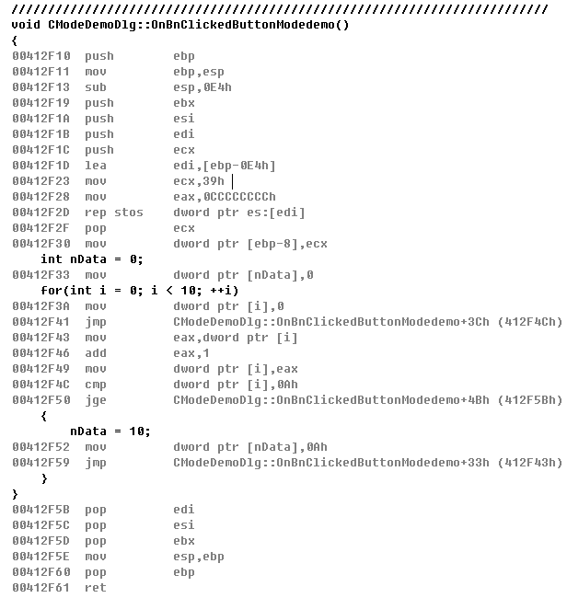
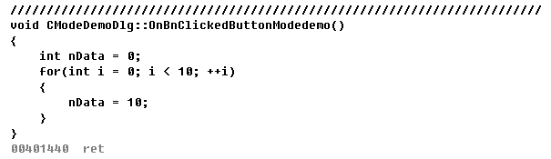
Build mode

Slide 32
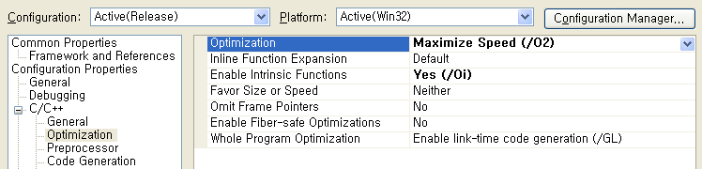
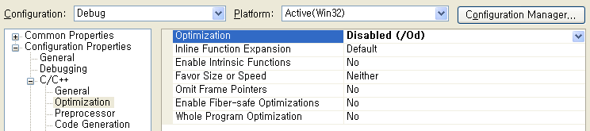
Build mode

Slide 33
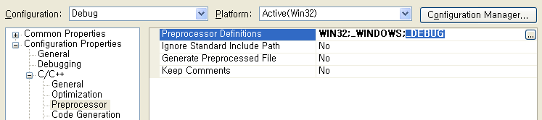
Build mode
4
5 #include "stdafx.h"
6 #include "ModeDemo.h"
7 #include "ModeDemoDlg.h"
8
9 ////////////////////////////////////////////////////////////////////
10 #ifdef _DEBUG
11 #define new DEBUG_NEW
12 #endif
13

Slide 34
Build mode
1343 #if defined(_DEBUG) && !defined(_AFX_NO_DEBUG_CRT)
1344
1345 // Memory tracking allocation
1346 void* AFX_CDECL operator new(size_t nSize, LPCSTR lpszFileName, int nLine);
1347 #define DEBUG_NEW new(THIS_FILE, __LINE__)
1348 #if _MSC_VER >= 1200
1349 void AFX_CDECL operator delete(void* p, LPCSTR lpszFileName, int nLine);
1350 #endif
1351

Slide 35
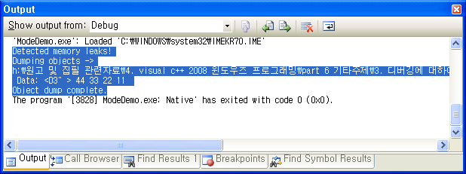
Build mode
168
169 void CModeDemoDlg::OnBnClickedButtonMemoryleak( )
170 {
171 int* pnData = new int;
172
173 *pnData = 0x11223344;
174 }
175

Slide 36
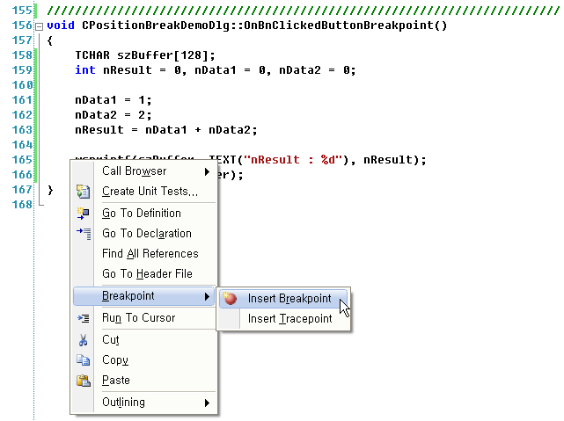
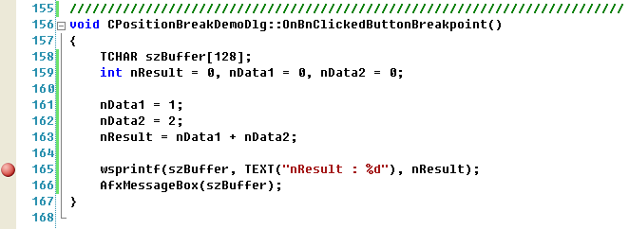
Breakpoint

Slide 37
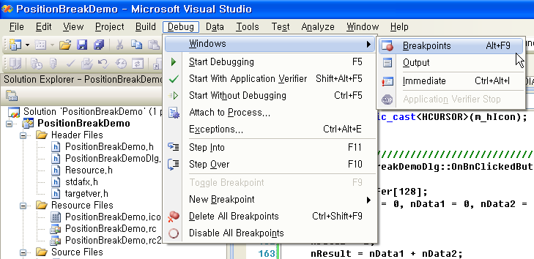
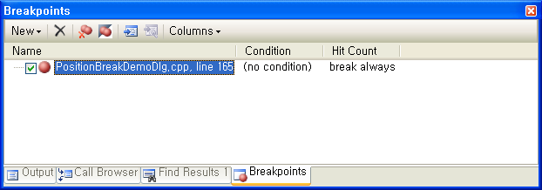
Breakpoint

Slide 38
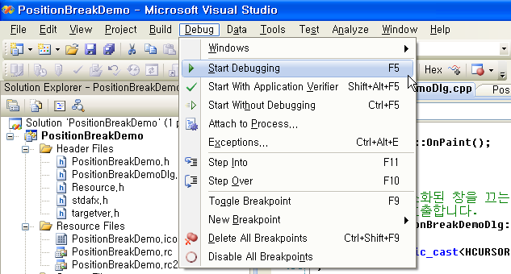
Breakpoint – Start Debugging

Slide 39
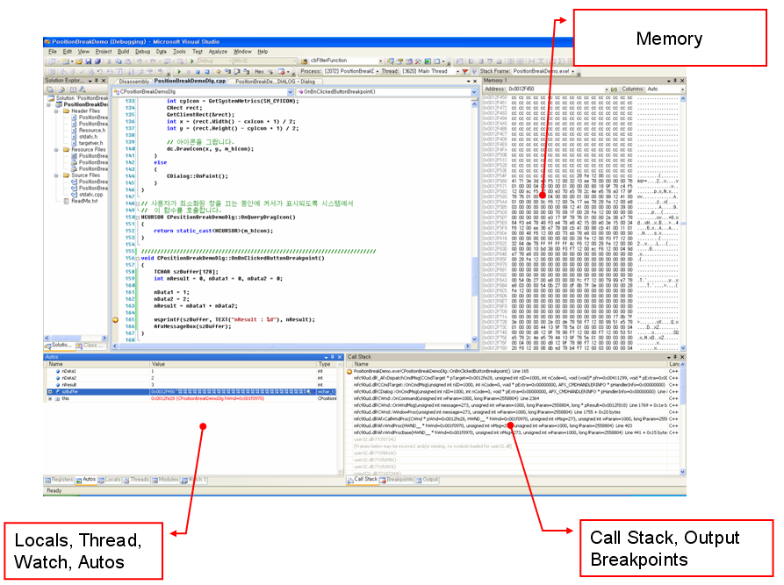
Breakpoint – Debug mode UI

Slide 40
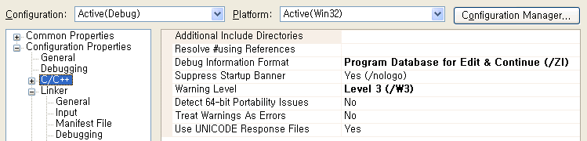
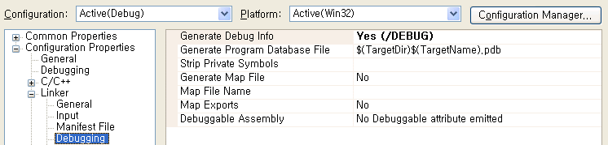

PDB file & Call stack

Slide 41
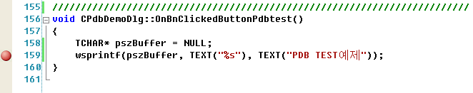
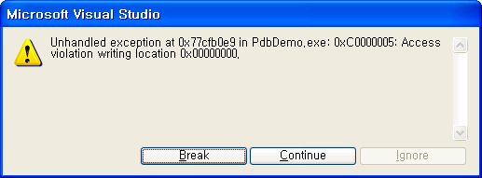
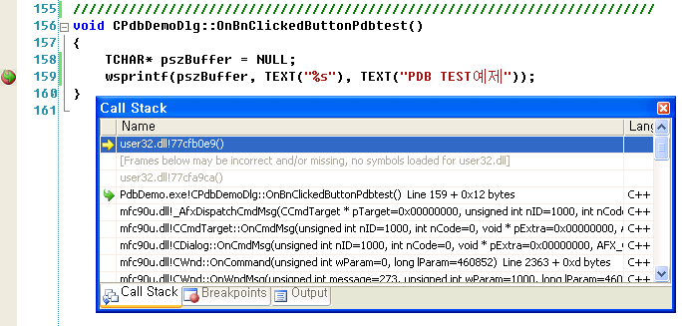
PDB file & Call stack

Slide 42
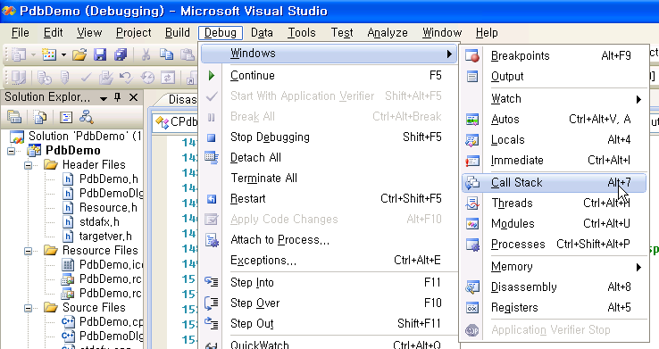
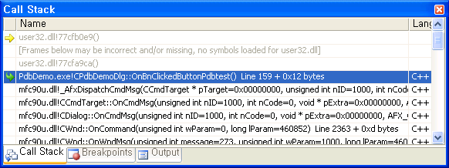
PDB file & Call stack

Slide 43
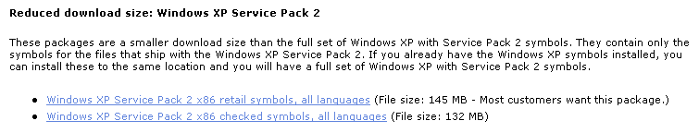
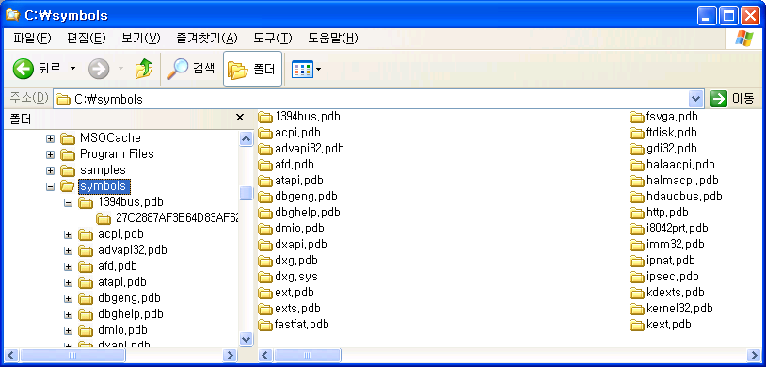
Windows OS symbol
http://www.microsoft.com/whdc/devtools/debugging/symbolpkg.mspx

Slide 44
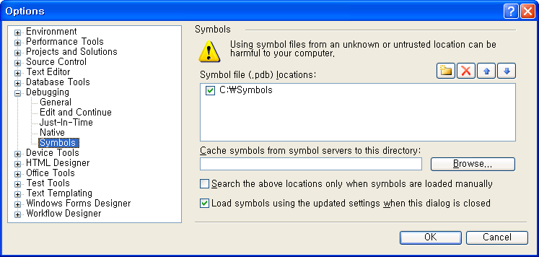
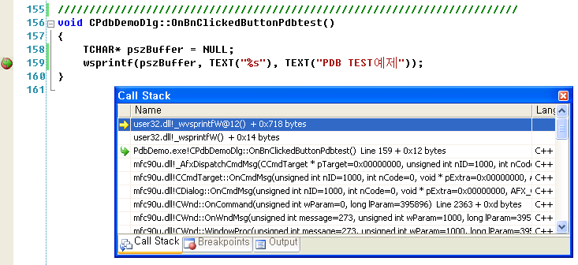
Windows OS symbol
http://www.microsoft.com/whdc/devtools/debugging/symbolpkg.mspx

Slide 45
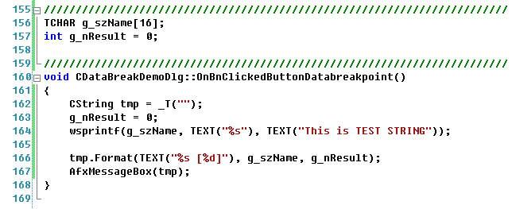
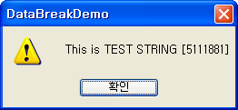
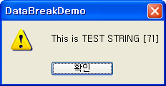
Data breakpoint

Slide 46
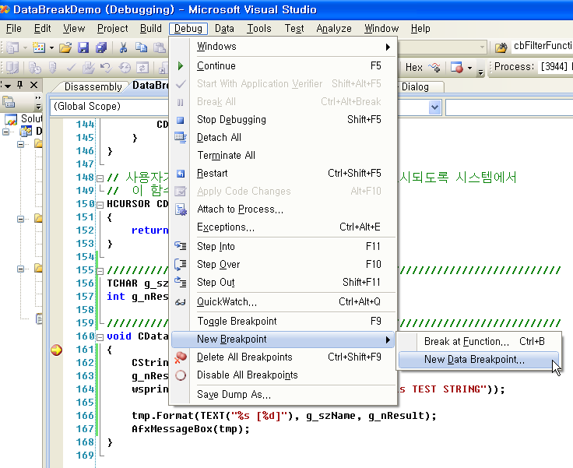
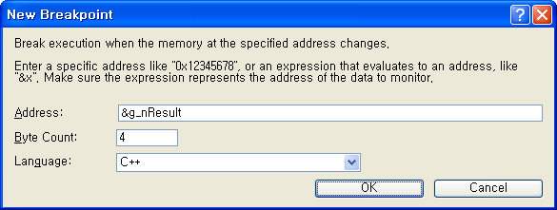
Data breakpoint

Slide 47
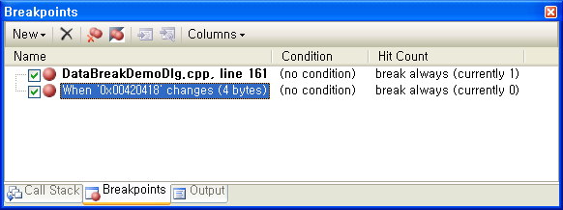
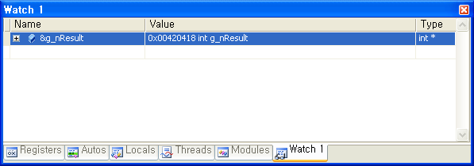
Data breakpoint

Slide 48
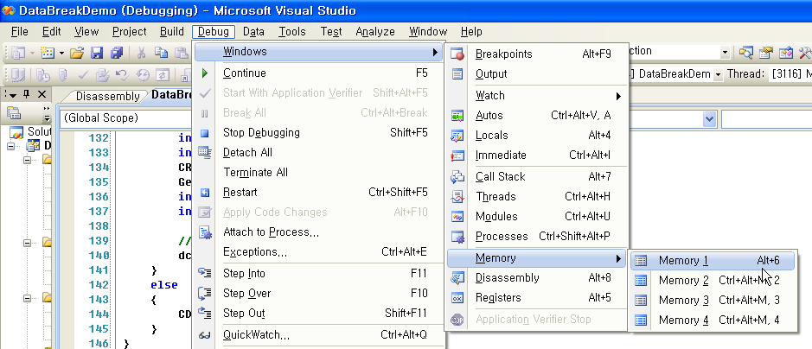
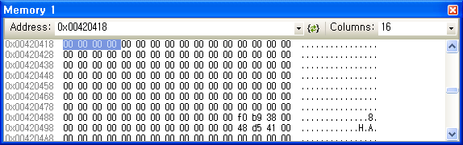
Data breakpoint – Memory debug window

Slide 49
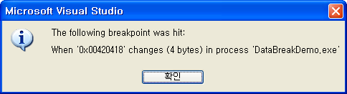
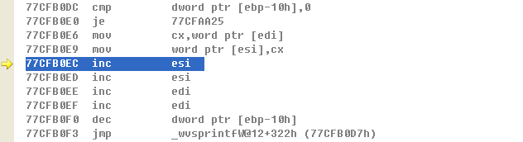
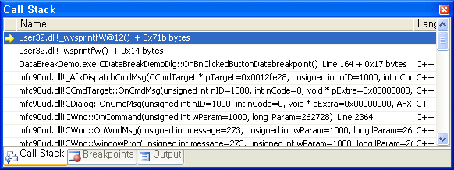
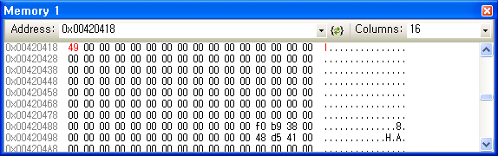
Data breakpoint – Memory debug window

Slide 50
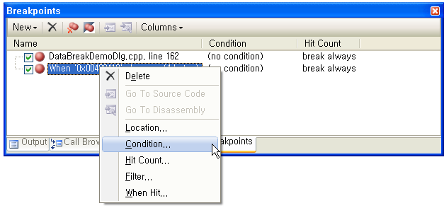
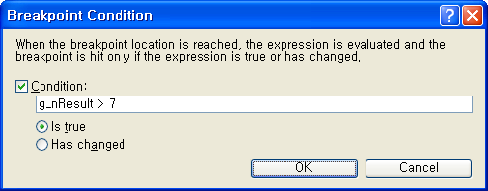
Data breakpoint - Condition

Slide 51
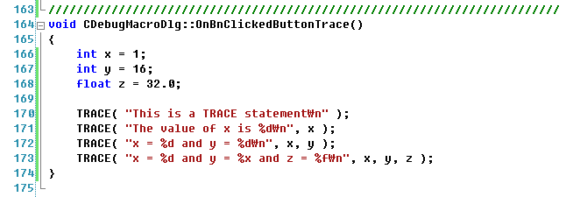
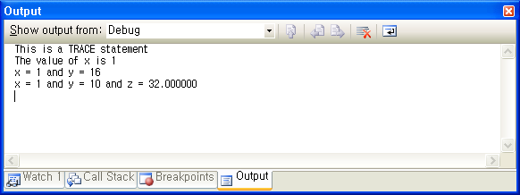
Debug macro & function

Slide 52


Debug macro & function

Slide 53


Debug macro & function

Slide 54

Debug macro & function

Slide 55


Attach to Process

Slide 56


Attach to Process

Slide 57


Remote debugging

Slide 58



Remote debugging

Slide 59



Remote debugging

Slide 60

Remote debugging

Slide 61

Remote debugging

Slide 62
Chapter 36
  Database

Slide 63


UserData Table

Slide 64


ODBC

Slide 65



ODBC

Slide 66

ODBC

Slide 67


ODBC - Sample Code

Slide 68



ODBC - Sample Code

Slide 69

ODBC - Sample Code

Slide 70
ODBC - Sample Code
19
20 COdbcDemoSet::COdbcDemoSet(CDatabase* pdb)
21 : CRecordset(pdb)
22 {
23 m_SeqNum = 0;
24 m_Name = L"";
25 m_PhoneNumber = L"";
26 m_Address = L"";
27 m_Age = 0;
28 m_nFields = 5;
29 m_nDefaultType = dynaset;
30 }
31 #error Security Issue: The connection string may contain a password
32 // The connection string below may contain plain text passwords and/or
33 // other sensitive information. Please remove the #error after reviewing
34 // the connection string for any security related issues. You may want to
35 // store the password in some other form or use a different user authentication.

Slide 71


ODBC - Sample Code

Slide 72
ODBC - Sample Code
25
26 Long m_SeqNum;
27 CStringW m_Name;
28 CStringW m_PhoneNumber;
29 CStringW m_Address;
30 Long m_Age;
31
32 // Overrides
33 // Wizard generated virtual function overrides
34 public:
35 virtual CString GetDefaultConnect( ); // Default connection string
36
37 virtual CString GetDefaultSQL( ); // default SQL for Recordset
38 virtual void DoFieldExchange(CFieldExchange* pFX); // RFX support
39

Slide 73
ODBC - Sample Code
5
6 #pragma once
7
8 class COdbcDemoSet;
9
10 class COdbcDemoView : public CRecordView
11 {
12 protected: // serialization에서만 만들어집니다.
13 COdbcDemoView( );
14 DECLARE_DYNCREATE(COdbcDemoView)
15
16 public:
17 enum{ IDD = IDD_ODBCDEMO_FORM };
18 COdbcDemoSet* m_pSet;
19

Slide 74
ODBC - Sample Code
5
6 #pragma once
7 #include "OdbcDemoSet.h"
8
9
10 class COdbcDemoDoc : public CDocument
11 {
12 protected: // serialization에서만 만들어 집니다.
13 COdbcDemoDoc( );
14 DECLARE_DYNCREATE(COdbcDemoDoc)
15
16 // 특성입니다.
17 public:
18 COdbcDemoSet m_OdbcDemoSet;
19

Slide 75
ODBC - Sample Code
143
144 void COdbcDemoView::ListupAllRecords(void)
145 {
146 CString strTmp = _T("");
147 if(m_pSet->IsBOF( )) return;
148
149 while(!m_pSet->IsEOF( ))
150 {
151 m_List.InsertItem(0, m_pSet->m_Name, 0);
152 m_List.SetItemText(0, 1, m_pSet->m_PhoneNumber);
153 m_List.SetItemText(0, 2, m_pSet->m_Address);
154
155 strTmp.Format(_T("%ld"), m_pSet->m_Age);
156 m_List.SetItemText(0, 3, strTmp);
157 m_pSet->MoveNext( );
158 }
159
160 m_pSet->MoveLast( );
161 }
162

Slide 76
ODBC - Sample Code
171
172 void COdbcDemoView::DisplayRecord(void)
173 {
174 m_strName = m_pSet->m_Name;
175 m_strPhoneNumber = m_pSet->m_PhoneNumber;
176 m_strAddress = m_pSet->m_Address;
177 m_lAge = m_pSet->m_Age;
178
179 UpdateData(FALSE);
180 }
181

Slide 77
ODBC - Sample Code
186
187 void COdbcDemoView::OnRecordFirst( )
188 {
189 m_pSet->MoveFirst( );
190 DisplayRecord( );
191 }
192
193 void COdbcDemoView::OnRecordLast( )
194 {
195 m_pSet->MoveLast( );
196 DisplayRecord( );
197 }
198
199 void COdbcDemoView::OnRecordNext( )
200 {
201 m_pSet->MoveNext( );
202 DisplayRecord( );
203 }
204
205 void COdbcDemoView::OnRecordPrev( )
206 {
207 m_pSet->MovePrev( );
208 DisplayRecord( );
209 }
210

Slide 78
ODBC - Sample Code
211
212 void COdbcDemoView::OnBnClickedButtonAddnew( )
213 {
214 if(!UpdateData( )) return;
215
216 m_pSet->MoveLast( );
217 m_pSet->AddNew( );
218 m_pSet->SetFieldNull(NULL);
219
220 m_pSet->m_Name = m_strName;
221 m_pSet->m_PhoneNumber = m_strPhoneNumber;
222 m_pSet->m_Address = m_strAddress;
223 m_pSet->m_Age = m_lAge;
224
225 m_pSet->Update( );
226 m_pSet->Requery( );
227
228 if(m_List.GetItemCount( ) > 0) m_List.DeleteAllItems( );
229 ListupAllRecords( );
230 }
231

Slide 79
ODBC - Sample Code
251
252 void COdbcDemoView::OnBnClickedButtonDeletecurrent( )
253 {
254 m_pSet->Delete( );
255 }
256
257
258 void COdbcDemoView::OnBnClickedButtonFindrecord( )
259 {
260 m_pSet->m_strFilter = _T("PhoneNumber = '02-2345-2345'");
261 m_pSet->Requery( );
262
263 if(m_List.GetItemCount( ) > 0) m_List.DeleteAllItems( );
264 ListupAllRecords( );
265 }
266

Slide 80
ODBC - Sample Code
251
252 void COdbcDemoView::OnBnClickedButtonDeletecurrent( )
253 {
254 m_pSet->Delete( );
255 }
256
257
258 void COdbcDemoView::OnBnClickedButtonFindrecord( )
259 {
260 m_pSet->m_strFilter = _T("PhoneNumber = '02-2345-2345'");
261 m_pSet->Requery( );
262
263 if(m_List.GetItemCount( ) > 0) m_List.DeleteAllItems( );
264 ListupAllRecords( );
265 }
266

Slide 81


OLE-DB - Sample Code

Slide 82


OLE-DB - Sample Code

Slide 83


OLE-DB - Sample Code

Slide 84



OLE-DB - Sample Code

Slide 85
OLE-DB - Sample Code
45
46 void GetRowsetProperties(CDBPropSet* pPropSet)
47 {
48 pPropSet->AddProperty(DBPROP_CANFETCHBACKWARDS, true, DBPROPOPTIONS_OPTIONAL);
49 pPropSet->AddProperty(DBPROP_CANSCROLLBACKWARDS, true, DBPROPOPTIONS_OPTIONAL);
50 }
51
52 HRESULT OpenDataSource( )
53 {
54 CDataSource _db;
55 HRESULT hr;
56 #error Security Issue: The connection string may contain a password

Slide 86
OLE-DB - Sample Code
9
10 class COleDBDemoSetAccessor
11 {
12 public:
13 LONG m_SeqNum;
14 TCHAR m_Name[51];
15 TCHAR m_PhoneNumber[51];
16 TCHAR m_Address[51];
17 LONG m_Age;
18
92
93 class COleDBDemoSet : public CTable<CAccessor<COleDBDemoSetAccessor> >
94 {
95 public:
96 HRESULT OpenAll( )
97 {
98 HRESULT hr;
99 hr = OpenDataSource( );
100 if (FAILED(hr))
101 return hr;

Slide 87
OLE-DB - Sample Code
9
10 class COleDBDemoDoc : public CDocument
11 {
12 protected: // serialization에서만 만들어집니다.
13 COleDBDemoDoc( );
14 DECLARE_DYNCREATE(COleDBDemoDoc)
15
16 // 특성입니다.
17 public:
18 COleDBDemoSet m_OleDBDemoSet;
19

Slide 88
OLE-DB - Sample Code
57
58 void COleDBDemoView::OnInitialUpdate( )
59 {
60 m_pSet = &GetDocument( )->m_OleDBDemoSet;
61 {
62 CWaitCursor wait;
63 HRESULT hr = m_pSet->OpenAll( );
64 if (FAILED(hr))
{
87
88 COleDBRecordView::OnInitialUpdate( );
89
90 if(m_List.GetHeaderCtrl( )->GetItemCount( ) <= 0)
91 {
92 m_List.InsertColumn(0, _T("Name"), LVCFMT_LEFT, 100);
93 m_List.InsertColumn(1, _T("Phone number"), LVCFMT_LEFT, 150);
94 m_List.InsertColumn(2, _T("Address"), LVCFMT_LEFT, 200);
95 m_List.InsertColumn(3, _T("Age"), LVCFMT_LEFT, 50);
96 }
97
98 ListupAllRecords( );
99 }
100

Slide 89
OLE-DB - Sample Code
173
174 void COleDBDemoView::ListupAllRecords(void)
175 {
176 CString strTmp = _T("");
177 m_pSet->MoveFirst( );
178 do
179 {
180 m_List.InsertItem(0, m_pSet->m_Name, 0);
181 m_List.SetItemText(0, 1, m_pSet->m_PhoneNumber);
182 m_List.SetItemText(0, 2, m_pSet->m_Address);
183
184 strTmp.Format(_T("%ld"), m_pSet->m_Age);
185 m_List.SetItemText(0, 3, strTmp);
186 }
187 while(m_pSet->MoveNext( ) != DB_S_ENDOFROWSET);
188
189 m_pSet->MoveFirst( );
190 }
191

Slide 90
OLE-DB - Sample Code
45
46 void GetRowsetProperties(CDBPropSet* pPropSet)
47 {
48 pPropSet->AddProperty(DBPROP_CANFETCHBACKWARDS, true, DBPROPOPTIONS_OPTIONAL);
49 pPropSet->AddProperty(DBPROP_CANSCROLLBACKWARDS, true, DBPROPOPTIONS_OPTIONAL);
50 pPropSet->AddProperty(DBPROP_UPDATABILITY,
51 DBPROPVAL_UP_CHANGE |
52 DBPROPVAL_UP_INSERT |
53 DBPROPVAL_UP_DELETE);
54 }
55

Slide 91
OLE-DB - Sample Code
96
97 //class COleDBDemoSet : public CTable<CAccessor<COleDBDemoSetAccessor> >
98 class COleDBDemoSet : public CCommand<CAccessor<COleDBDemoSetAccessor> >
99 {
100 public:
101 HRESULT OpenAll( )
102 {

Slide 92
OLE-DB - Sample Code
132
133 HRESULT OpenRowset(DBPROPSET *pPropSet = NULL)
134 {
135 // HRESULT hr = Open(m_session, L"UserData", pPropSet);
136 CString strSQL = _T("SELECT * FROM UserData");
137 HRESULT hr = Open(m_session, strSQL, pPropSet);
138 #ifdef _DEBUG
139 if(FAILED(hr))
140 AtlTraceErrorRecords(hr);
141 #endif
142 return hr;
143 }
144

Slide 93
OLE-DB - Sample Code
144
145 HRESULT RunSQL(CString strSQL, DBPROPSET *pPropSet = NULL)
146 {
147 Close( );
148 ReleaseCommand( );
149 HRESULT hr = Open(m_session, strSQL, pPropSet);
150 return hr;
151 }
152
153 void CloseAll( )
154 {
155 Close( );
156 CloseDataSource( );
157 }
158 };
159

Slide 94
OLE-DB - Sample Code
187
188 void COleDBDemoView::OnBnClickedButtonAddnew( )
189 {
190 CCommand<CDynamicAccessor> Cmd;
191
192 CDBPropSet propset(DBPROPSET_ROWSET);
193 propset.AddProperty(DBPROP_IRowsetChange, true);
194 propset.AddProperty(DBPROP_UPDATABILITY,
195 DBPROPVAL_UP_CHANGE |
196 DBPROPVAL_UP_INSERT |
197 DBPROPVAL_UP_DELETE);
198
199 HRESULT hr = Cmd.Open(m_pSet->m_session, _T("SELECT * FROM UserData"), &propset);
200 if(FAILED(hr))
201 {
202 AfxMessageBox(_T("ERROR: Failed to execute SQL!"));
203 }
204

Slide 95
OLE-DB - Sample Code
205 TCHAR* pszValue = NULL;
206 Cmd.SetStatus(1, DBSTATUS_S_IGNORE);
207
208 pszValue = (TCHAR*)Cmd.GetValue(2);
209 wsprintf(pszValue, _T("%s"), _T("김철수"));
210 Cmd.SetLength(2, lstrlen(pszValue) * 2);
211 Cmd.SetStatus(2, DBSTATUS_S_OK);
212
213 pszValue = (TCHAR*)Cmd.GetValue(3);
214 wsprintf(pszValue, _T("%s"), _T("02-5555-5555"));
215 Cmd.SetLength(3, lstrlen(pszValue) * 2);
216 Cmd.SetStatus(3, DBSTATUS_S_OK);
217
218 pszValue = (TCHAR*)Cmd.GetValue(4);
219 wsprintf(pszValue, _T("%s"), _T("부천시원미구상동"));
220 Cmd.SetLength(4, lstrlen(pszValue) * 2);
221 Cmd.SetStatus(4, DBSTATUS_S_OK);
222

Slide 96
OLE-DB - Sample Code
223 ULONG* plAge = (ULONG*)Cmd.GetValue(5);
224 *plAge = 100;
225 Cmd.SetLength(5, sizeof(ULONG));
226 Cmd.SetStatus(5, DBSTATUS_S_OK);
227
228 hr = Cmd.Insert( );
229 if(FAILED(hr))
230 {
231 AfxMessageBox(_T("ERROR: Failed to Insert new record!"));
232 }
233
234 Cmd.Close( );
235 Cmd.ReleaseCommand( );
236
237 if(m_List.GetItemCount( ) > 0) m_List.DeleteAllItems( );
238 m_pSet->RunSQL(_T("SELECT * FROM UserData"));
239 ListupAllRecords( );
240 }
241

Slide 97
OLE-DB - Sample Code
241
242 void COleDBDemoView::OnBnClickedButtonModifyrecord( )
243 {
244 CCommand<CDynamicAccessor> Cmd;
245
246 CDBPropSet propset(DBPROPSET_ROWSET);
247 propset.AddProperty(DBPROP_IRowsetChange, true);
248 propset.AddProperty(DBPROP_UPDATABILITY,
249 DBPROPVAL_UP_CHANGE |
250 DBPROPVAL_UP_INSERT |
251 DBPROPVAL_UP_DELETE);
252
253 HRESULT hr = Cmd.Open(m_pSet->m_session,
254 _T("SELECT * FROM UserData WHERE Name = '김철수'"),
255 &propset);
256 if(FAILED(hr))
257 {
258 AfxMessageBox(_T("ERROR: Failed to execute SQL!"));
259 }

Slide 98
OLE-DB - Sample Code
260
261 Cmd.MoveFirst( );
262 TCHAR* pszValue = NULL;
263 Cmd.SetStatus(1, DBSTATUS_S_IGNORE);
264
265 ULONG* plAge = (ULONG*)Cmd.GetValue(5);
266 *plAge = 30;
267 Cmd.SetLength(5, sizeof(ULONG));
268 Cmd.SetStatus(5, DBSTATUS_S_OK);
269
270 hr = Cmd.SetData( );
271 if(FAILED(hr))
272 {
273 AfxMessageBox(_T("ERROR: Failed to modify record!"));
274 }
275
276 Cmd.Update( );
277 Cmd.Close( );
278 Cmd.ReleaseCommand( );
279
280 if(m_List.GetItemCount( ) > 0) m_List.DeleteAllItems( );
281 m_pSet->RunSQL(_T("SELECT * FROM UserData"));
282 ListupAllRecords( );
283 }
284

Slide 99
OLE-DB - Sample Code
284
285 void COleDBDemoView::OnBnClickedButtonDeleterecord( )
286 {
287 CCommand<CDynamicAccessor> Cmd;
288
289 CDBPropSet propset(DBPROPSET_ROWSET);
290 propset.AddProperty(DBPROP_IRowsetChange, true);
291 propset.AddProperty(DBPROP_UPDATABILITY,
292 DBPROPVAL_UP_CHANGE |
293 DBPROPVAL_UP_INSERT |
294 DBPROPVAL_UP_DELETE);
295
296 HRESULT hr = Cmd.Open(m_pSet->m_session,
297 _T("SELECT * FROM UserData WHERE Name = '김철수'"),
298 &propset);
299 if(FAILED(hr))
300 {
301 AfxMessageBox(_T("ERROR: Failed to execute SQL!"));
302 }
303

Slide 100
OLE-DB - Sample Code
304 Cmd.MoveFirst( );
305 hr = Cmd.Delete( );
306 if(FAILED(hr))
307 {
308 AfxMessageBox(_T("ERROR: Failed to delete record!"));
309 }
310
311 Cmd.Update( );
312 Cmd.Close( );
313 Cmd.ReleaseCommand( );
314
315 if(m_List.GetItemCount( ) > 0) m_List.DeleteAllItems( );
316 m_pSet->RunSQL(_T("SELECT * FROM UserData"));
317 ListupAllRecords( );
318 }
319

Slide 101
OLE-DB - Sample Code
304 Cmd.MoveFirst( );
305 hr = Cmd.Delete( );
306 if(FAILED(hr))
307 {
308 AfxMessageBox(_T("ERROR: Failed to delete record!"));
309 }
310
311 Cmd.Update( );
312 Cmd.Close( );
313 Cmd.ReleaseCommand( );
314
315 if(m_List.GetItemCount( ) > 0) m_List.DeleteAllItems( );
316 m_pSet->RunSQL(_T("SELECT * FROM UserData"));
317 ListupAllRecords( );
318 }
319

Slide 102
Chapter 37
  MFC Socket Programming

Slide 103
IP Address
0
32 bit IP address (IPv4)
31 bit
0xC0
0xA8
0x0A
0x09
192
168
10
9
0x C0 == 11000000 (8 bit)
Network ID
Class A
0XXXXXXX
Host ID
0.0.0.0 ~ 127.255.255.255
Class B
10XXXXXX
XXXXXXXX
128.0.0.0 ~ 191.255.255.255
Class C
110XXXXX
XXXXXXXX
XXXXXXXX
192.0.0.0 ~ 223.255.255.255
Class D
1110XXXX
Host group ID
224.0.0.0 ~ 239.255.255.255

Slide 104
Chat Server/Client
3
Add new client object to management list
1
Chatting Server
Client object list
2
Connect to
Server
5
Send string to all connected client
4
Send string
Chatting Client 1
Chatting Client 2
Chatting Client 3
6
Display string

Slide 105

ChatServer
48
49 CWinAppEx::InitInstance( );
50
51 if (!AfxSocketInit( ))
52 {
53 AfxMessageBox(IDP_SOCKETS_INIT_FAILED);
54 return FALSE;
55 }

Slide 106
ChatServer
6
7 #include "afxwin.h"
8 #include "ListenSocket.h"
9
10 // CChatServerDlg 대화 상자
11 class CChatServerDlg : public CDialog
12 {
13 // 생성입니다.
14 public:
15 CChatServerDlg(CWnd* pParent = NULL); // 표준 생성자입니다.
16 CListenSocket m_ListenSocket;
17

Slide 107
ChatServer
2
3 // CListenSocket command target
4
5 class CListenSocket : public CAsyncSocket
6 {
7 public:
8 CListenSocket( );
9 virtual ~CListenSocket( );
10
11 CPtrList m_ptrClientSocketList;
12 };
13

Slide 108
ChatServer
21
22 void CListenSocket::OnAccept(int nErrorCode)
23 {
24 CClientSocket* pClient = new CClientSocket;
25 if(Accept(*pClient))
26 {
27 pClient->SetListenSocket(this);
28 m_ptrClientSocketList.AddTail(pClient);
29 }
30 else
31 {
32 delete pClient;
33 AfxMessageBox(_T("ERROR: Failed to accept new client!"));
34 }
35
36 CAsyncSocket::OnAccept(nErrorCode);
37 }
38

Slide 109
ChatServer
38
39 void CListenSocket::CloseClientSocket(CSocket* pClient)
40 {
41 POSITION pos;
42 pos = m_ptrClientSocketList.Find(pClient);
43 if(pos != NULL)
44 {
45 if(pClient != NULL)
46 {
47 pClient->ShutDown( );
48 pClient->Close( );
49 }
50
51 m_ptrClientSocketList.RemoveAt(pos);
52 delete pClient;
53 }
54 }
55

Slide 110
ChatServer
55
56 void CListenSocket::SendChatDataAll(TCHAR* pszMessage)
57 {
58 POSITION pos;
59 pos = m_ptrClientSocketList.GetHeadPosition( );
60 CClientSocket* pClient = NULL;
61
62 while(pos != NULL)
63 {
64 pClient = (CClientSocket*)m_ptrClientSocketList.GetNext(pos);
65 if(pClient != NULL)
66 {
67 pClient->Send(pszMessage, lstrlen(pszMessage) * 2);
68 }
69 }
70 }
71

Slide 111
ChatServer
4
5 class CClientSocket : public CSocket
6 {
7 public:
8 CClientSocket( );
9 virtual ~CClientSocket( );
10
11 CAsyncSocket* m_pListenSocket;
12
13 };
14
22
23 void CClientSocket::SetListenSocket(CAsyncSocket* pSocket)
24 {
25 m_pListenSocket = pSocket;
26 }
27

Slide 112
ChatServer
28
29 void CClientSocket::OnClose(int nErrorCode)
30 {
31 CSocket::OnClose(nErrorCode);
32
33 CListenSocket* pServerSocket = (CListenSocket*)m_pListenSocket;
34 pServerSocket->CloseClientSocket(this);
35 }
36

Slide 113
ChatServer
37
38 void CClientSocket::OnReceive(int nErrorCode)
39 {
40 CString strTmp = _T(""), strIPAddress = _T("");
41 UINT uPortNumber = 0;
42 TCHAR szBuffer[1024];
43 ::ZeroMemory(szBuffer, sizeof(szBuffer));
44
45 GetPeerName(strIPAddress, uPortNumber);
46 if(Receive(szBuffer, sizeof(szBuffer)) > 0)
47 {
48 CChatServerDlg* pMain = (CChatServerDlg*)AfxGetMainWnd( );
49 strTmp.Format(_T("[%s:%d] : %s"), strIPAddress, uPortNumber, szBuffer);
50 pMain->m_List.AddString(strTmp);
51 pMain->m_List.SetCurSel(pMain->m_List.GetCount( ) -1);
52
53 CListenSocket* pServerSocket = (CListenSocket*)m_pListenSocket;
54 pServerSocket->SendChatDataAll(szBuffer);
55 }
56
57 CSocket::OnReceive(nErrorCode);
58 }
59

Slide 114
ChatServer
98 SetIcon(m_hIcon, TRUE); // 큰 아이콘을 설정합니다.
99 SetIcon(m_hIcon, FALSE); // 작은 아이콘을 설정합니다.
100
101 if(m_ListenSocket.Create(21000, SOCK_STREAM))
102 {
103 if(!m_ListenSocket.Listen( ))
104 {
105 AfxMessageBox(_T("ERROR: Listen( ) return FALSE"));
106 }
107 }
108 else
109 {
110 AfxMessageBox(_T("ERROR: Failed to create server socket!"));
111 }
112
113 return TRUE; // 포커스를 컨트롤에 설정하지 않으면 TRUE를 반환합니다.
114 }
115

Slide 115
ChatServer
168 void CChatServerDlg::OnDestroy( )
169 {
170 CDialog::OnDestroy( );
171
172 POSITION pos;
173 pos = m_ListenSocket.m_ptrClientSocketList.GetHeadPosition( );
174 CClientSocket* pClient = NULL;
175
176 while(pos != NULL)
177 {
178 pClient = (CClientSocket*)
179 m_ListenSocket.m_ptrClientSocketList.GetNext(pos);
180 if(pClient != NULL)
181 {
182 pClient->ShutDown( );
183 pClient->Close( );
184
185 delete pClient;
186 }
187 }
188
189 m_ListenSocket.ShutDown( );
190 m_ListenSocket.Close( );
191 }

Slide 116
ChatClient
4
5 #pragma once
6 #include "afxwin.h"
7 #include "ConnectSocket.h"
8
9 // CChatClientDlg 대화상자
10 class CChatClientDlg : public CDialog
11 {
12 // 생성입니다.
13 public:
14 CChatClientDlg(CWnd* pParent = NULL); // 표준 생성자입니다.
15 CConnectSocket m_Socket;
16

Slide 117
ChatClient
21
22 void CConnectSocket::OnClose(int nErrorCode)
23 {
24 ShutDown( );
25 Close( );
26
27 CSocket::OnClose(nErrorCode);
28
29 AfxMessageBox(_T("ERROR: Disconnected from server!"));
30 ::PostQuitMessage(0);
31 }
32

Slide 118
ChatClient
32
33 void CConnectSocket::OnReceive(int nErrorCode)
34 {
35 TCHAR szBuffer[1024];
36 ::ZeroMemory(szBuffer, sizeof(szBuffer));
37
38 if(Receive(szBuffer, sizeof(szBuffer)) > 0)
39 {
40 CChatClientDlg* pMain = (CChatClientDlg*)AfxGetMainWnd( );
41 pMain->m_List.AddString(szBuffer);
42 pMain->m_List.SetCurSel(pMain->m_List.GetCount( ) -1);
43 }
44
45 CSocket::OnReceive(nErrorCode);
46 }
47

Slide 119
ChatClient
100 SetIcon(m_hIcon, TRUE); // 큰 아이콘을 설정합니다.
101 SetIcon(m_hIcon, FALSE); // 작은 아이콘을 설정합니다.
102
103 m_Socket.Create( );
104 if(m_Socket.Connect(_T("127.0.0.1"), 21000) == FALSE)
105 {
106 AfxMessageBox(_T("ERROR: Failed to connect server"));
107 PostQuitMessage(0);
108
109 return FALSE;
110 }
111
112 return TRUE; // 포커스를 컨트롤에 설정하지 않으면 TRUE를 반환합니다.
113 }
114

Slide 120
ChatClient
165
166 void CChatClientDlg::OnBnClickedButtonSend( )
167 {
168 UpdateData(TRUE);
169 m_Socket.Send((LPVOID)(LPCTSTR)m_strMessage,
170 m_strMessage.GetLength( ) * 2);
171
172 m_strMessage = _T("");
173 UpdateData(FALSE);
174 }
175

Slide 121

ChatClient

